Slide 1
0x108 – Automotive Systems
ECED4406 – Computer Security
Dr. Colin O’Flynn
Dalhousie University.

Slide 2
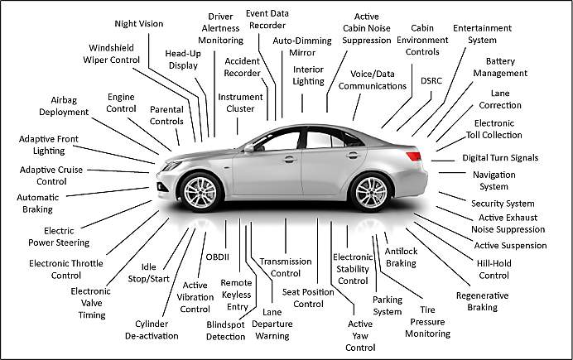
Automotive Electronics
https://www.eenewsautomotive.com/design-center/automotive-service-era-electronic-car

Slide 3
Automotive Considerations:
Safety is normally the first requirement (before security).
Devices have some level of cost considerations.
Devices have very long lifespans.
People keep cars for 5-15 years often (or more!).
Many modules are reused across many car models.

Slide 4
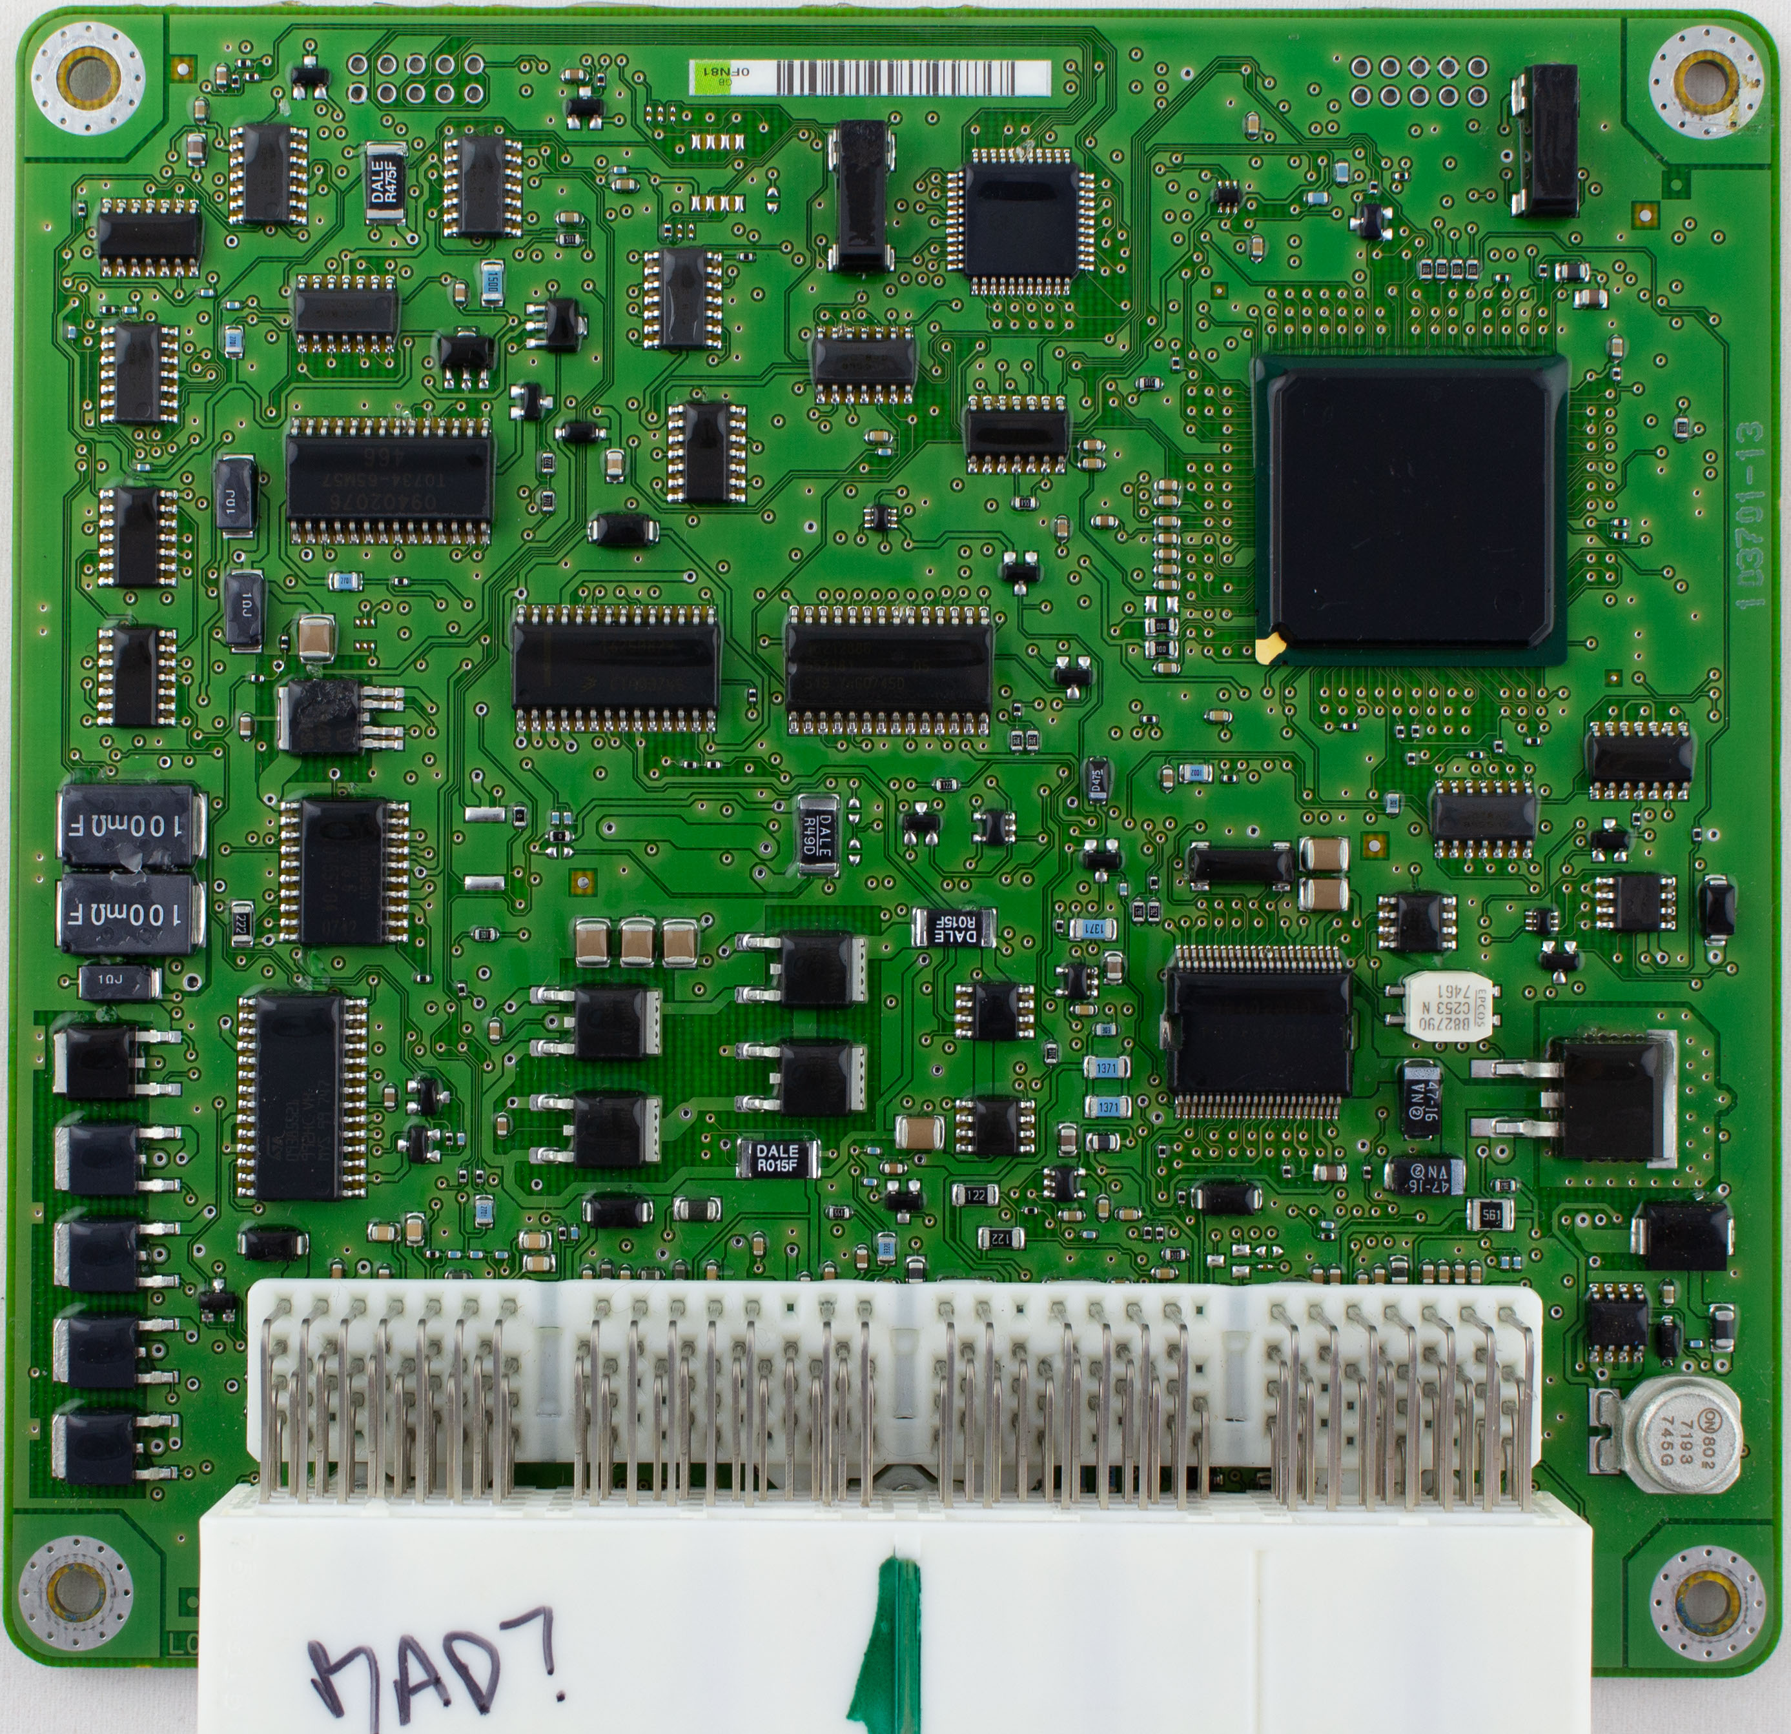
Example of Automotive Electronics
This is an (older) electronic control unit (ECU) – newer ones aren’t too different.
Also called Engine Control Unit (ECU) if main engine controller such as this.
Handles the various engine tasks required for car to go.

Slide 5
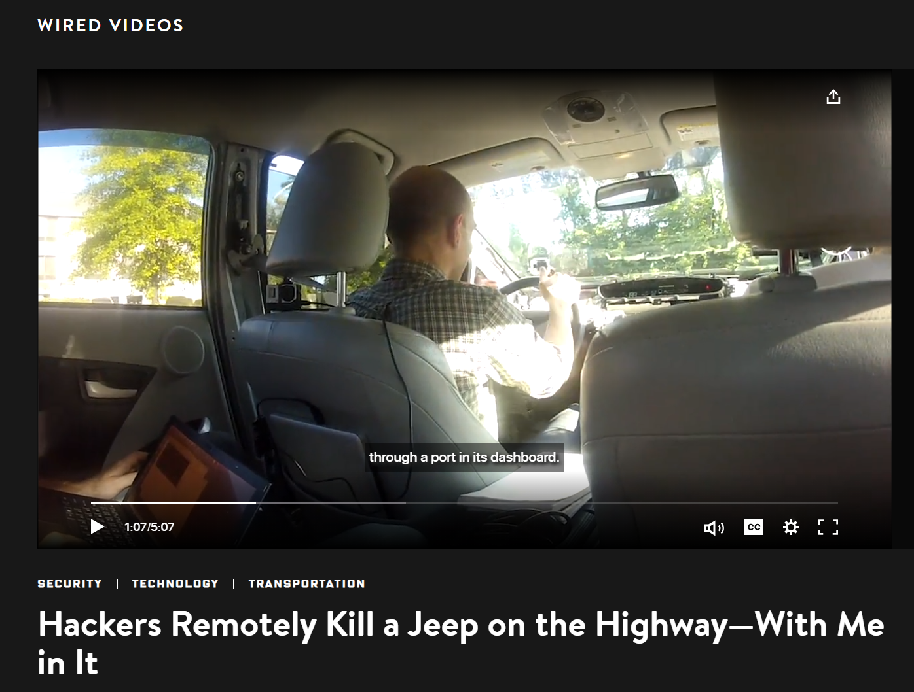
Automotive Electronics Systems - Threats
https://www.wired.com/video/watch/hackers-wireless-jeep-attack-stranded-me-on-a-highway

Slide 6
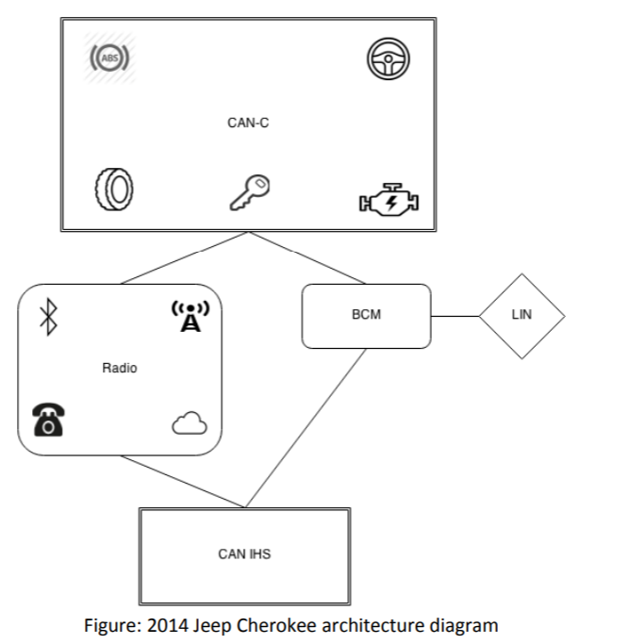
Remote Exploitation of an Unaltered Passenger Vehicle
Unsecure radio network was “always on” with connection to car.
Allowed finding location of any vehicle in the group (large group of vehicles possible).
More advanced attacks allowed re-writing of radio code.
From there could re-write code in other modules.
http://illmatics.com/Remote%20Car%20Hacking.pdf

Slide 7
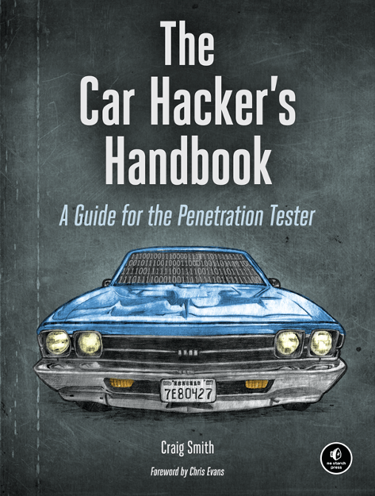
Getting Started with Car Hacking
Physical book available – also as a PDF for free!
http://opengarages.org/handbook/

Slide 8

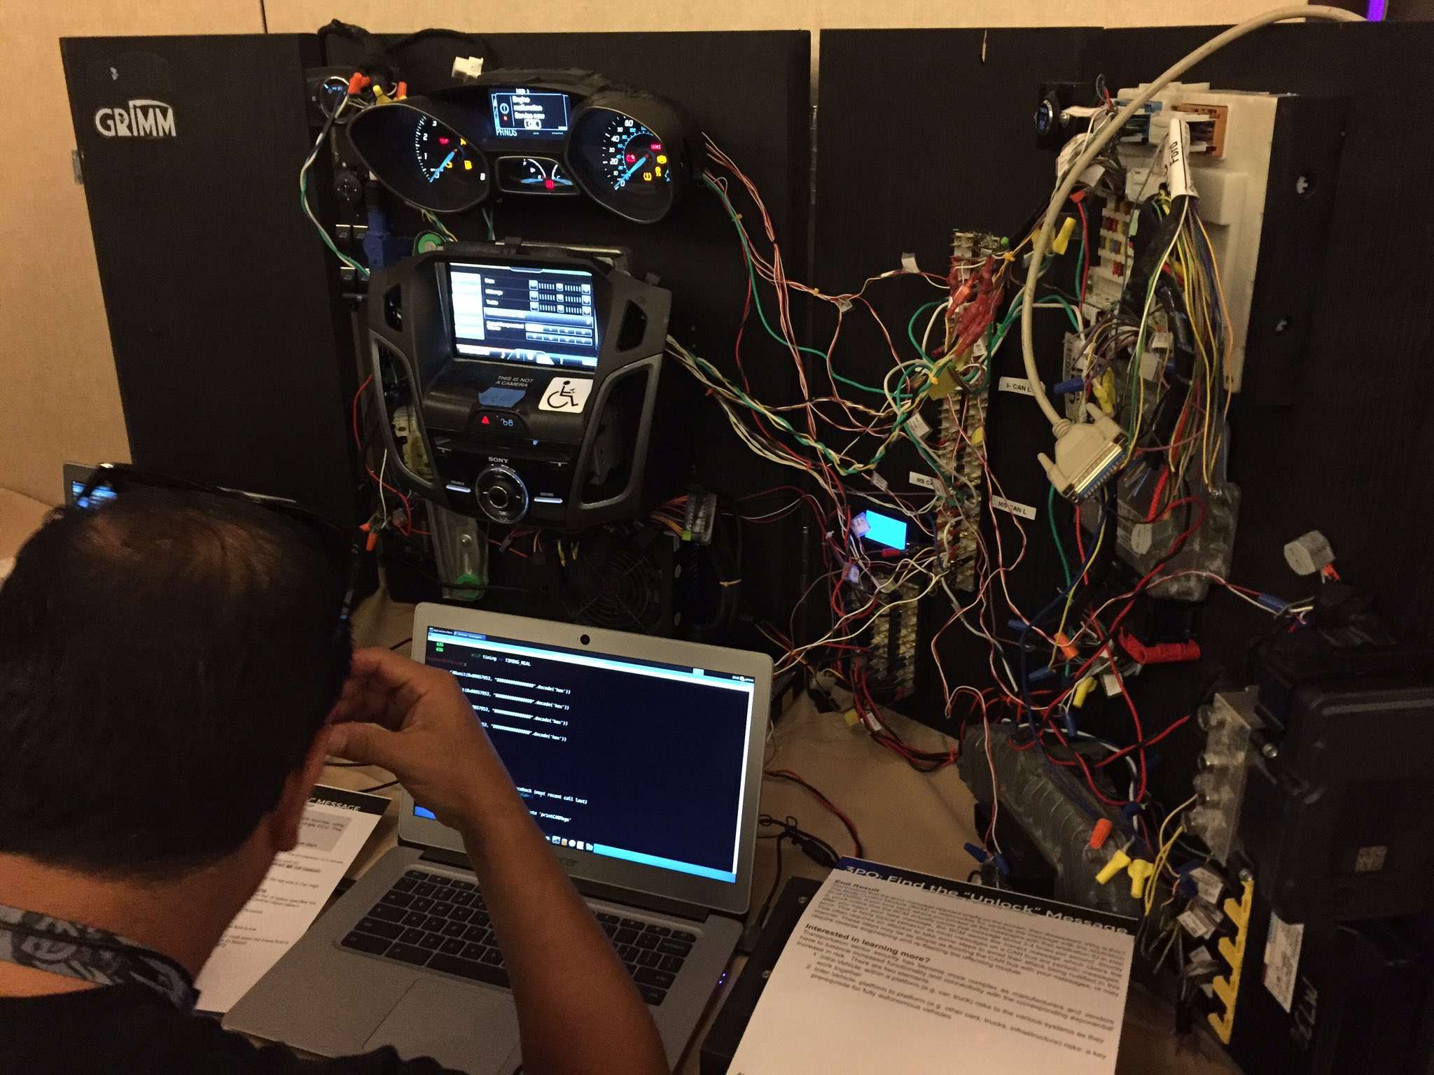
More Car Hacking Resources
https://www.carhackingvillage.com/

